Slide 1
MediaTek
PeiKuan Lin
kwang997@gmail.com
0912768499

Slide 2
Outline
Hi Touch Designer
Bridge Board FW
Windows-based application
2nd bridge board FW
Bridge Board Verification tool

Slide 3
Hi Touch Designer
Hi Touch Designer
Host
Cypress library API
USB interface
USB protocal
Bridge board
I2C Bus
Touch IC

Slide 4
CFG
CFG
Hi Touch Designer
FW
FW
Load Config.
Edit Config.
Save Config.
Misc.
Program & Load configuration
IC & Channel Mapping
Register Editor
Instant Performance Fine Tune
Observe Raw Data & Performance
Save Configuration
Gesture Demo
Deme Panel
Notes:
In the following, I want to introduce how to observe the raw data and coordinate data. After finish the mapping function, if we put one finger on the touch panel, we could see that the signal show on the screen and move in the same direction as the finger.
But we may have other problems and expect to improve its performance. For example, the line could be broken in the middle while we have our finger move along. This is because the finger signal is not big enough in the middle of its path. So the line is disconnected.
As for other problems, such as the report rate is too long and it can not meet the customer’s requirement.
Therefore, we have to tune several parameters in order to achieve a satisfied performance.

Slide 5
Hi Touch Designer
Developed and maintained a large-scale windows-based program.
Communicate with the bridge board
Set the voltage and launch register r/w command.
Get touch IC data from the bridge board for observation
Fine-tune the parameter and save it into exported firmware.
Refractor and rework for different IC type and FW version.

Slide 6
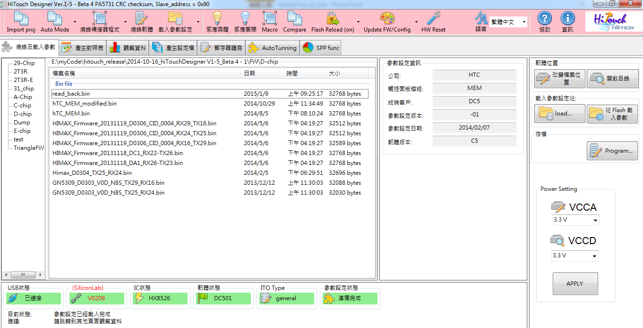
Hi Touch Designer
The outlook of Program & Load FW page
Notes:
This is the outlook of the hiTouch Designer. At the bottom shows the connected status
Connected status : If we connected the Touch IC into the computer, a series of initialization would be launched, such as bridge board FW checking, Touch IC FW version checking, and IC type recognition.
On the right-handed side was VCCA/VCCD setting panel .We could adjust the voltage of the digital and analog by click the combobox and then click the apply Button and the desired voltage would be set.
On the left-hand side is a FW management panel. In this tool, there is a directory called FW and there are many sub-folder which consists of many FW files. For example, there is a sub-folder called D-chip, and if we click this node. It will show every FW files of this sub-folder in the middle panel and they are all corresponding to the D-chip.
After the members of FW teams finish developing the FW, they will release the latest FW to me, so that I could compress it and the tool together and release the compressed file to the other FAE or colleagues.

Slide 7
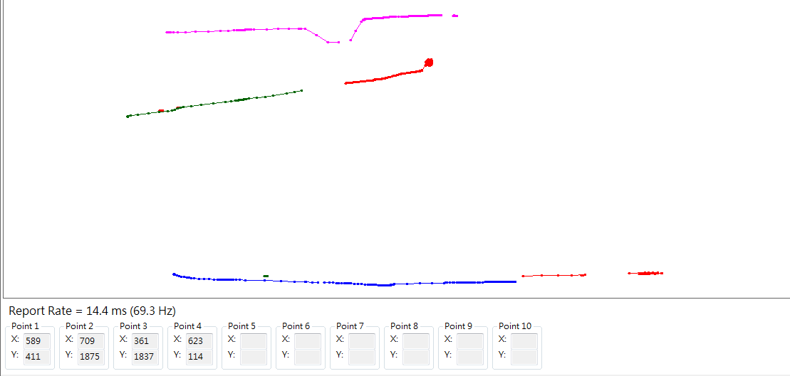
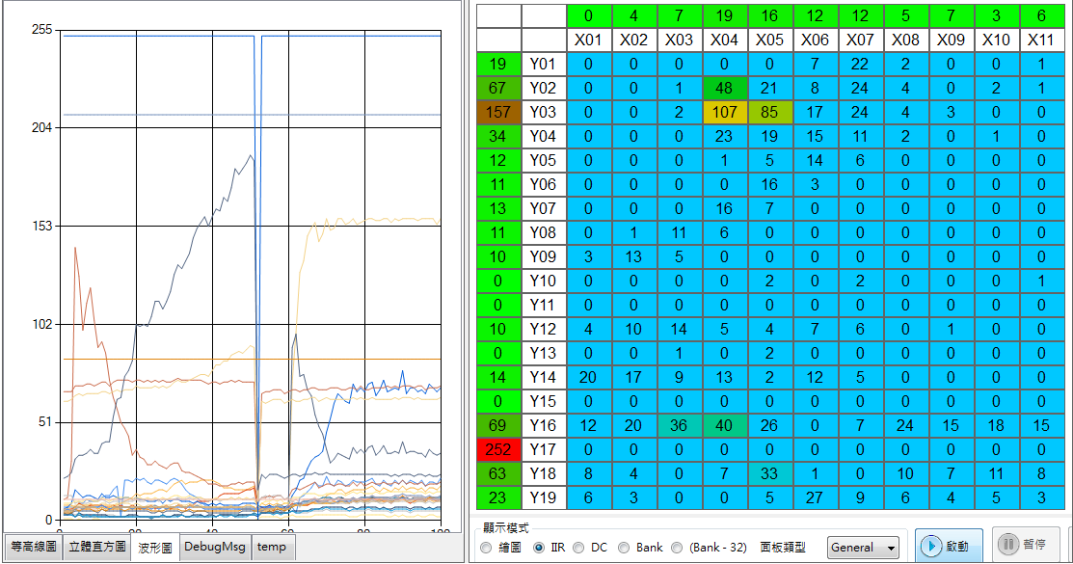
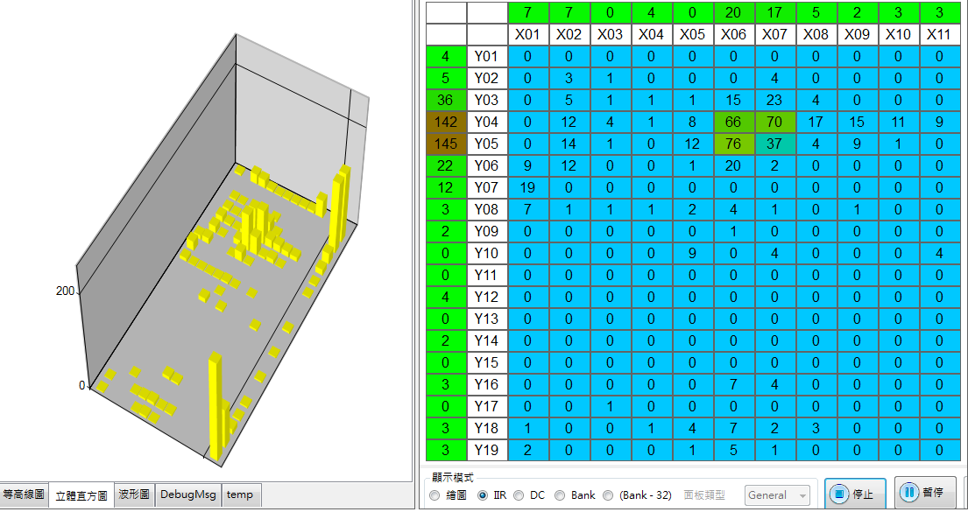
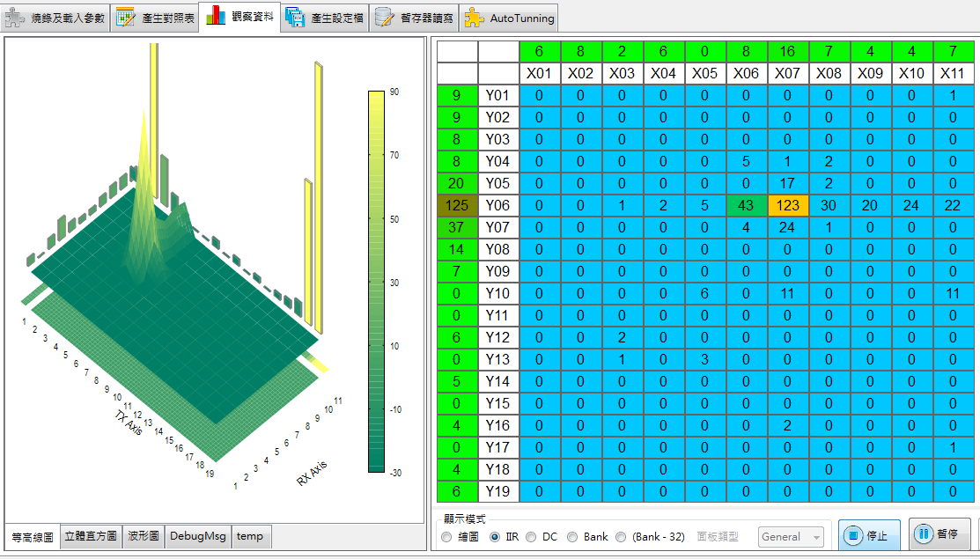
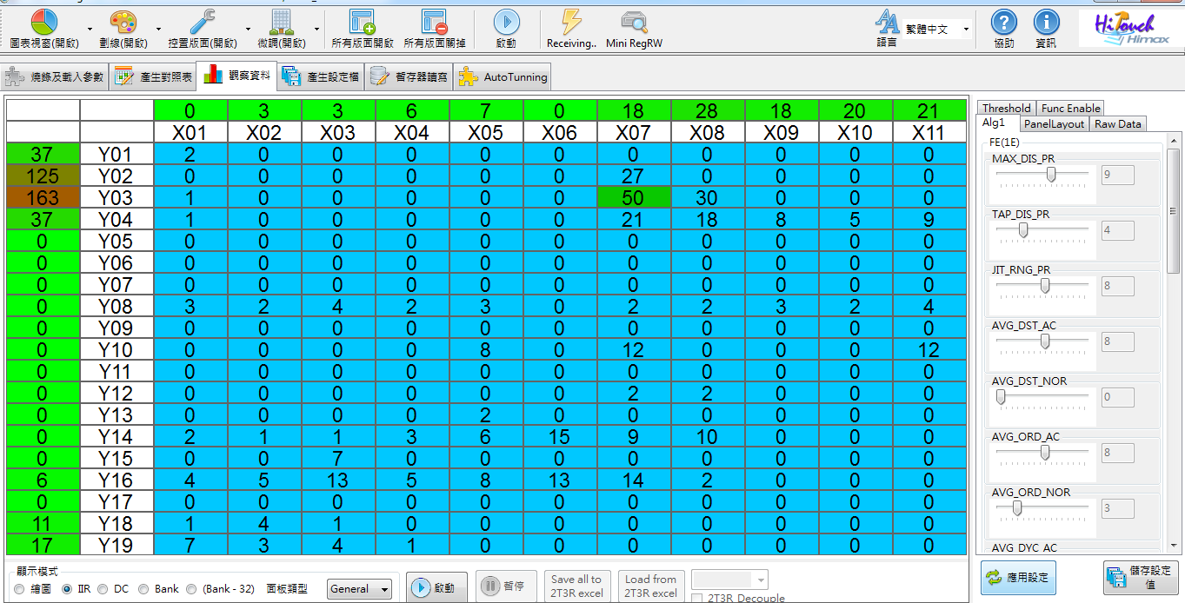
Hi Touch Designer
Draw Mode
Waveform View
3D Model View
Histogram View
Notes:
As for the observation panel, we have multiple way to present the capacity difference.
At first, the capacity difference shows as digital value and presented as a two-dimentional array.
Then, we could transform the digital values into the 3D model so that users could see the signal it in the different way.
We also could observe it in the histogram view and waveform view.
At last, since we are develop the touch firmware, its purpose is to report coordinate of the finger to the baseband. So we could treat the panel as a canvas and try to draw with our finger.
At the bottom, the report rate is indicated here and each X-Y tuple for each point is show at there.

Slide 8
Hi Touch Designer
Step 1. Tune the specific item.
Step 3. Check its efficacy.
Step 2. Click the apply setting.
Notes:
再來是介紹參數微調的部份，我們會針對某些 item 的 performance 不滿意或是遇到問題，例如說…雜訊太大，手指訊號太少，劃線不夠直，劃線會斷線…等等 … 就必須找相對應的參數作調整。
這個時候，就來使用右手邊這個 panel 並找到相對應的參數，作調整，如果調完之後，那就再到下面按下 apply ，應用目前的設定值。看觀查剛剛遇到的問題有無改善。
這一個 item 調整到滿意之後，再換下一個進行調適，一直到整體表現都尚可滿意為止。
最後再把所有設定值都在存成另一個新的 FW 。有點像打RPG 遊戲一樣，最後進行存檔，以方便之後的調閱和調適。
We may have some performance problem while we try to use our finger moving on the panel. Such as, if we want to draw a straight line on the panel, but the line is not straight enough or it will be broken in the middle. In the moment, we have to tune some parameter to improve its performance.
For example, there is a test item called jitter on the machine test. The machine arm will keep punch the touch panel at the same point and see whether the IC will report the same X-Y coordinate or not. If the signal is not strong enough or is interfered by any noise, the touch IC would not report the same X-Y coordinate as the previous point. Then the test is won’t be passed. Therefore, the FW team have one workaround to solve the issue.
Which is they pull one parameter call “ tap distance range”. It means that if the distance between the current point and the previous point is less the “TAP DISTANCe RANGE”, the touch IC will still report the previous point in order to have the test pass.
After tuning the parameter and click the “ apply setting “ button, users could see the efficacy on the left panel. If test item is pass, the FASE will keep tuning other parameters until the overall performance is satisfied.
At the end, we could click the “save setting” button to reserve the above new parameter into another exported FW.

Slide 9
Bridge Board FW
Maintain and develop Cypress FX2 firmware
Reduce code size down to 8k so for getting rid of the external ram
Auto-polling slave address.
Polling PC command from PC and transfer them into I2C signal
By monitor interrupt pin, receive Touch IC data and send them into host application.
Become HID device by modifying the descriptor table

Slide 10
Windows-based application
Incorporate Himax IC and Silicon lab chip to work on Win 8 environment
Modified from "USBPcap" open source project to catch the USB packet from USB hub and compose it as a two dimension array.
Windows-based multi-thread program.
BCB program
Modified from “simple HID” open source project
Has capability to do flash programming and register R/W

Slide 11
2nd generation bridge board FW
Porting FW code from Cypress FX2 platform into Silicon Lab chip
Since the change of High speed device to full speed device, the composing and dividing operation is necessary.
Modify the code of the Host AP and FW, so that the interaction would be compatible.
1-4 flash programming by SW I2C manipulation.
Program Touch FW by HW button click without connecting to PC.

Slide 12
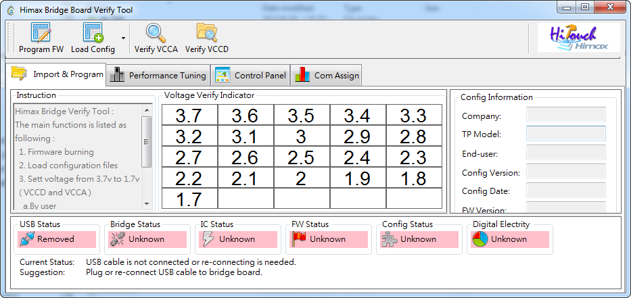
Bridge Board Verification tool
HiBridge Tool :
Verification of the voltage setting of analog and digital by connecting with the digital-Multimeter

Slide 13
Q&A

